Slide 1
Capstone Project - 2
Seoul Bike Sharing Demand Prediction
ML Supervised Regression
Individual Project:
Soumya Ranjan Mishra

Slide 2
Contents
● Problem Statement
● Data Summary
● Data Analysis
● Analysis Details
● Feature Selection
● Data Preparation
● Implementing Various Regression Algorithms
● Challenges
● Conclusions

Slide 3

Problem Statements
Prediction of bike count required at each hour.
Reduce waiting time of public.
AaAAna

Slide 4
Data Summary
● Date : Year-Month-Day
● Rented Bike Count - Count of bikes rented at each hour
● Hour - Hour of the day
● Temperature - Temperature in Celsius
● Humidity - %
● Windspeed - m/s
● Visibility - 10m
● Dew point temperature -Celsius
● Solar radiation -MJ/m2
● Rainfall -mm
● Snowfall -cm
● Seasons -Winter, Spring, Summer, Autumn
● Holiday -Holiday/No Holiday
● Functional Day - NoFunc(Non Functional Hrs),Fun(Functional Hrs)

Slide 5
Basic Data Exploration
● The dataset has 8760 rows and 14 features(columns).
● Three categorical features ‘Seasons’, ‘Holiday’, & ‘Functioning Day’.
● One Datetime[ns] features ‘Date’.
● Outliers present only in dependent variable.
●No Missing Values.
● No Duplicated values.
● No null values.

Slide 6
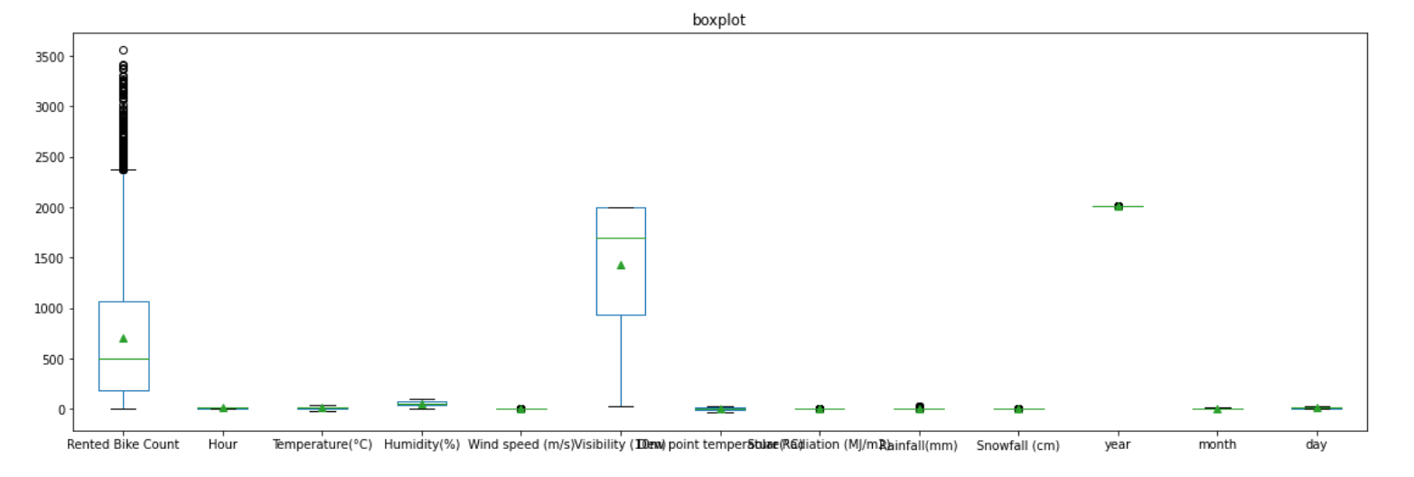
Outliers in the features

Slide 7
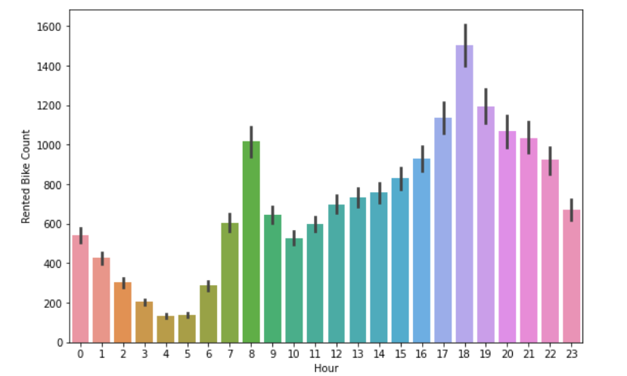
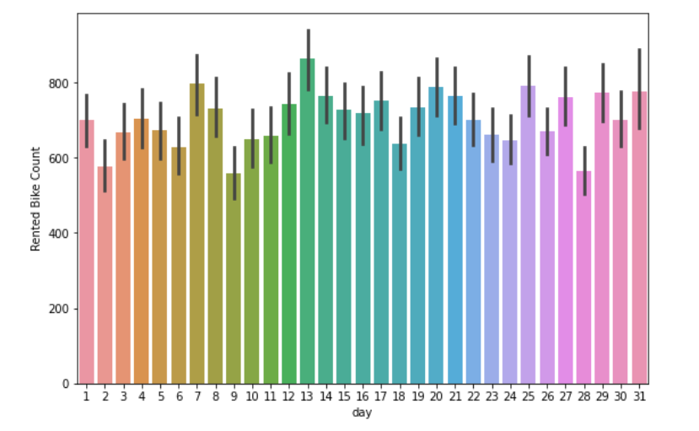
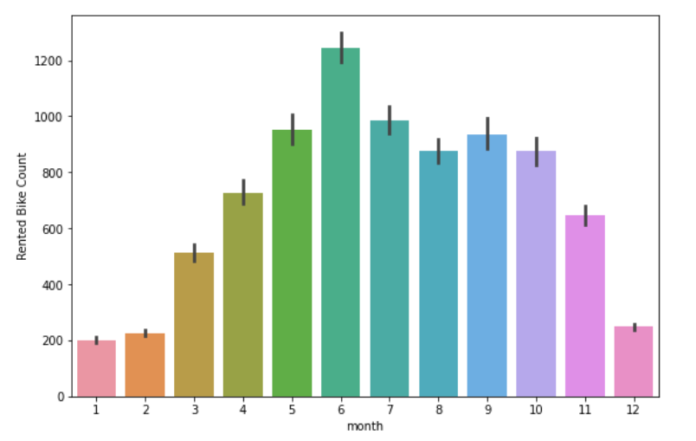
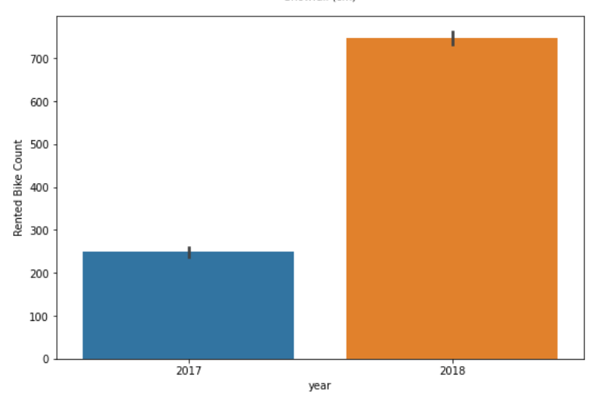
Mean Distribution of Rent Count

Slide 8
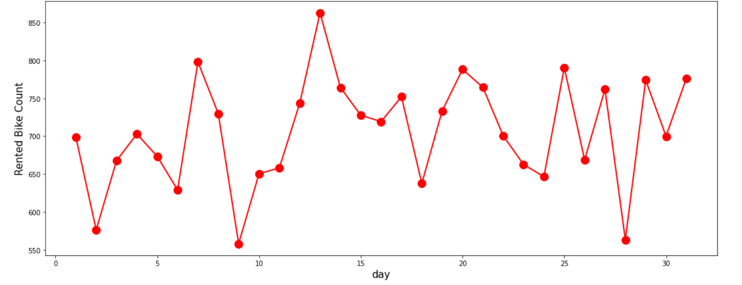
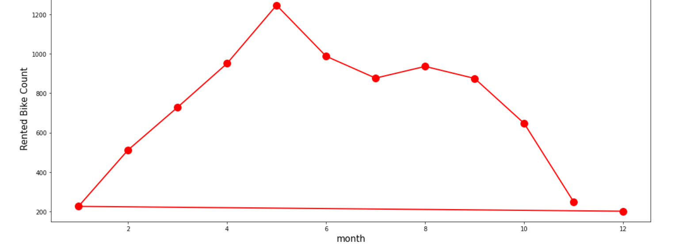
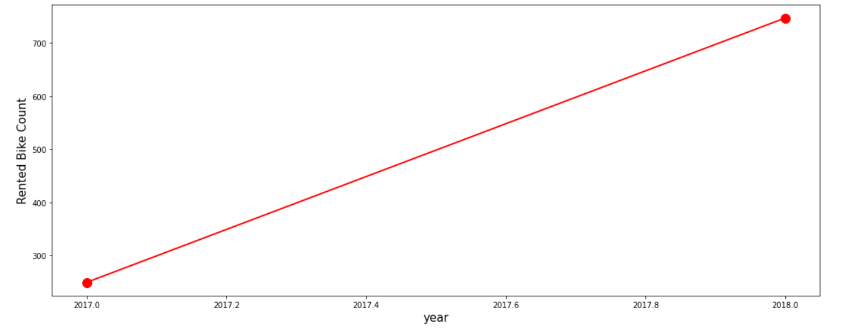
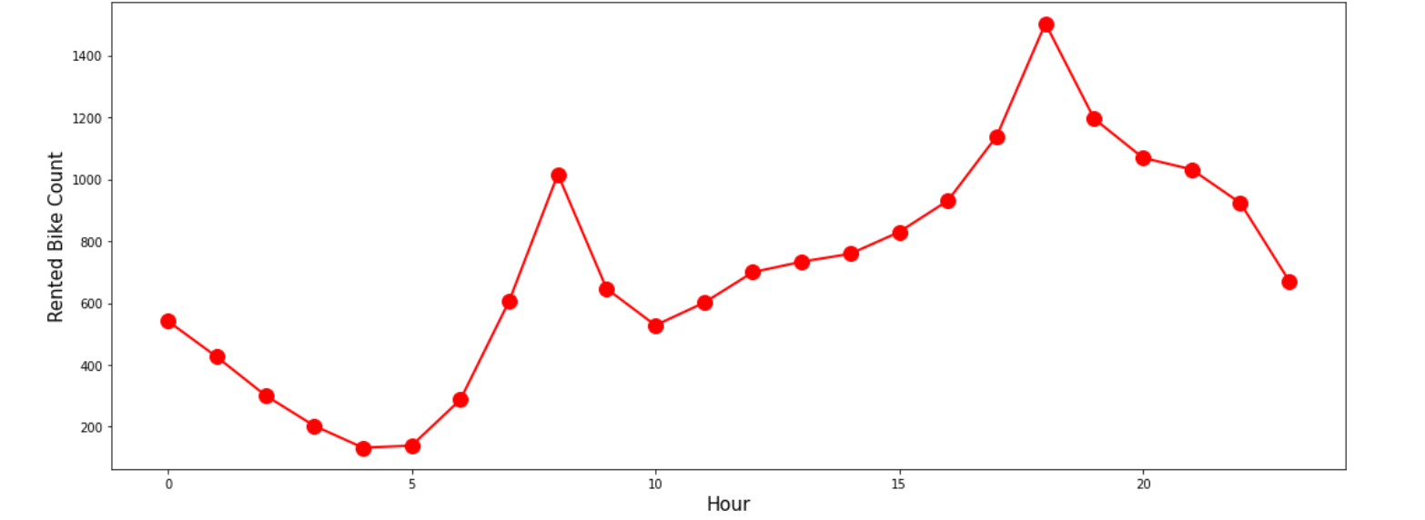
Rented Bike Spread over time

Slide 9
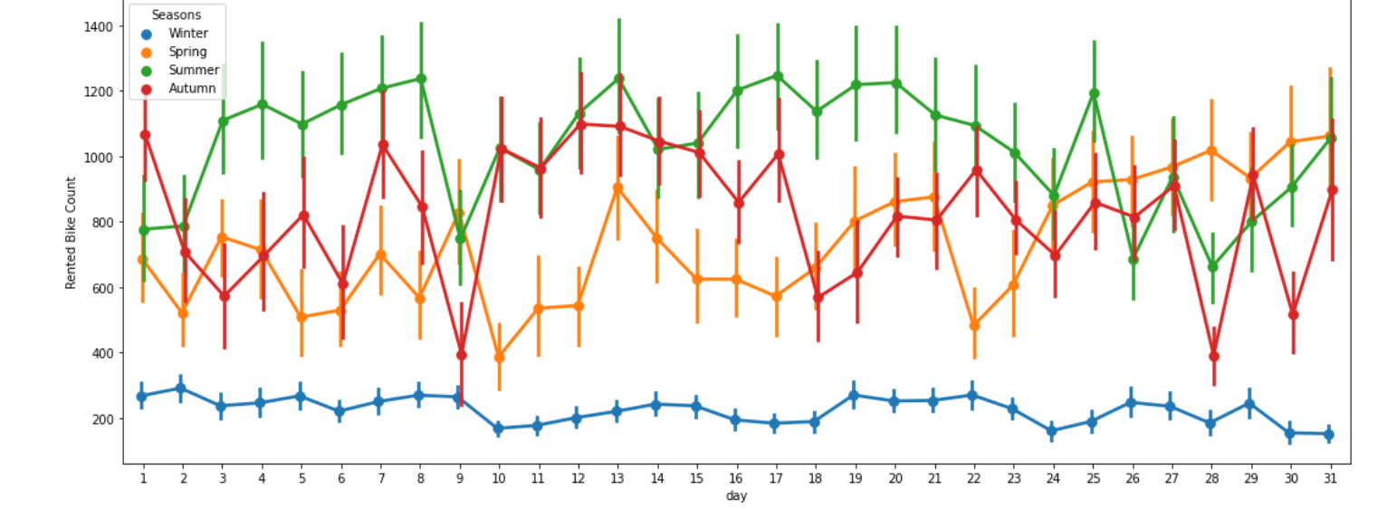
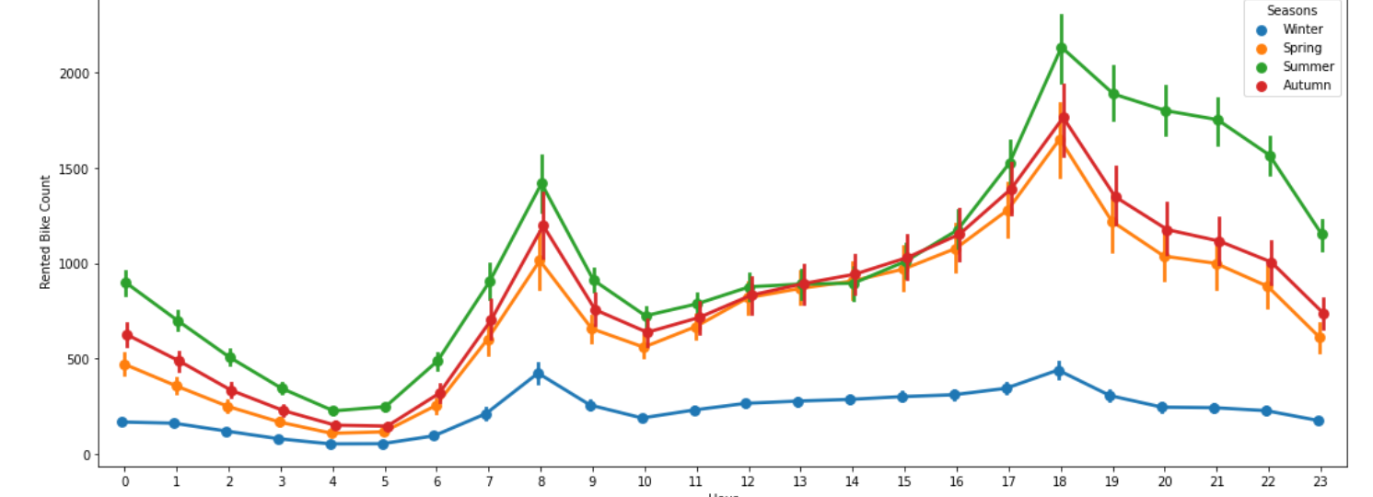
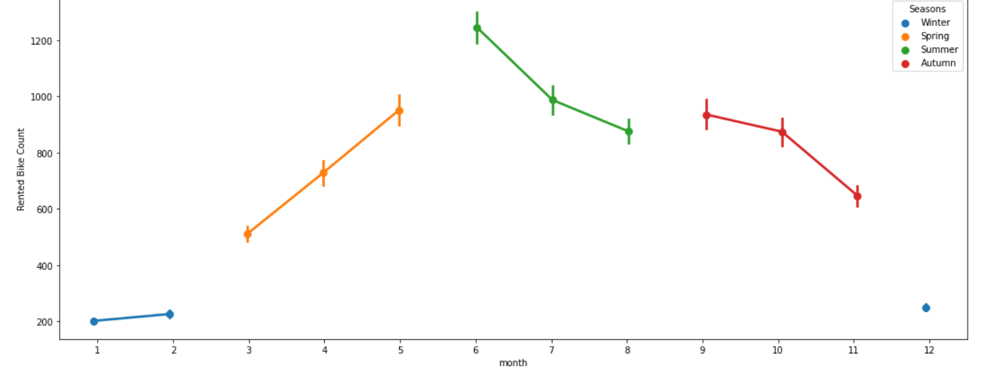
Rented Bike Spread over time and seasons

Slide 10
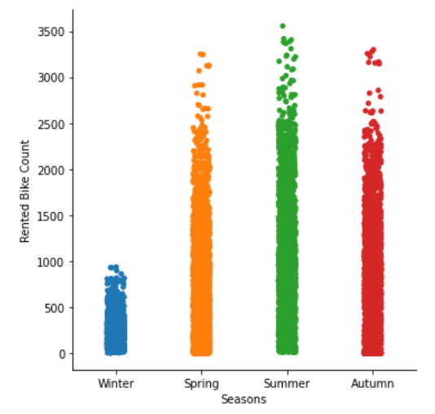
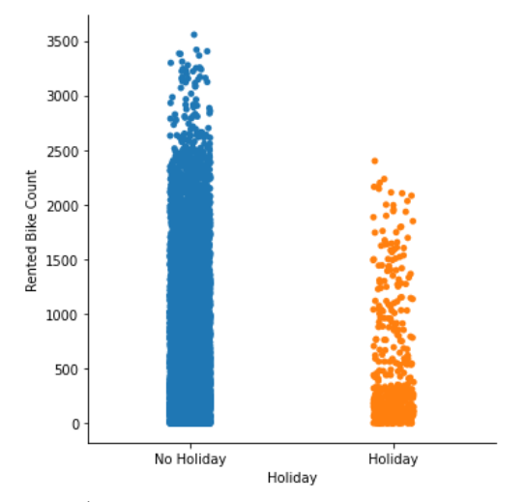
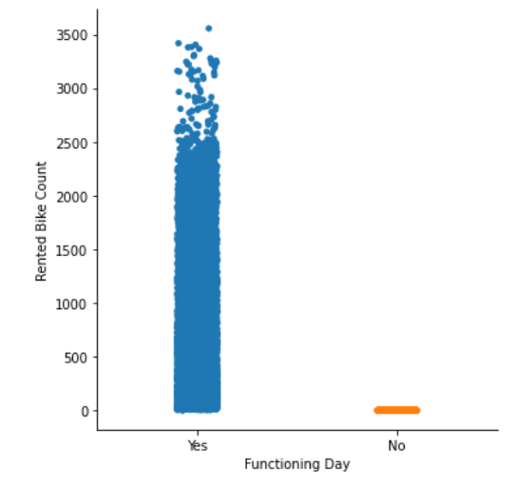
Spread of Categorical Variables

Slide 11
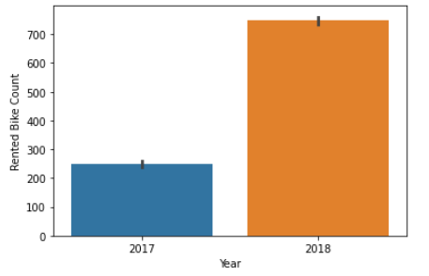
Distribution of Number of reviews

Slide 12
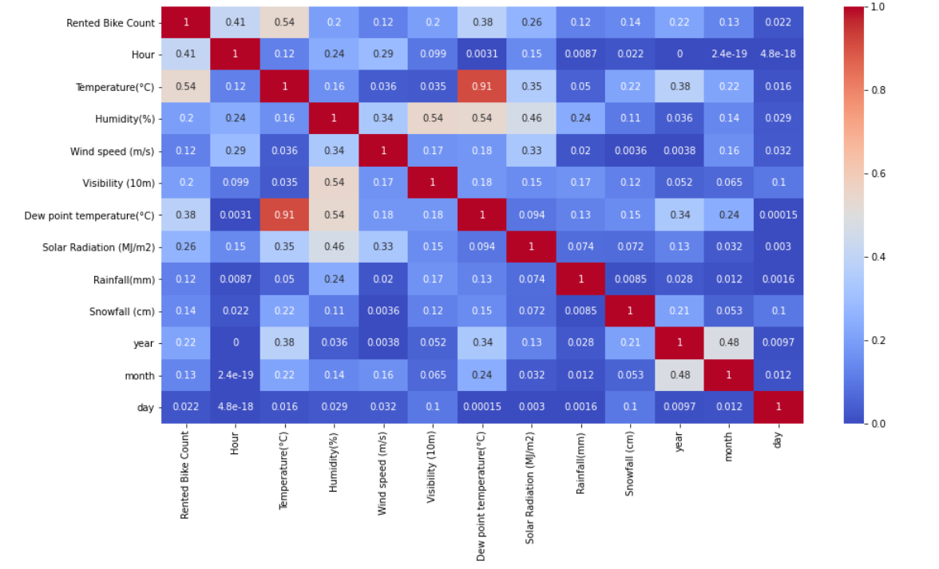
Correlation Matrix

Slide 13
Feature Selection
● Dropping Constant Feature Using Variance Threshold
● Feature Selection with Pearson Correlation

Slide 14
Data Preparation
● Label Encoding
● One Hot Encoding
● Train Test Split (test_size=0.3, random_state=0)

Slide 15
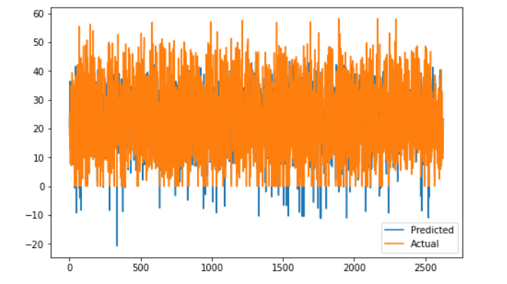
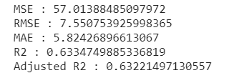
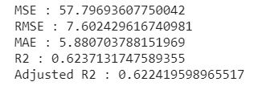

Linear Regression Train Set Metrics Test Set Metrics

Slide 16
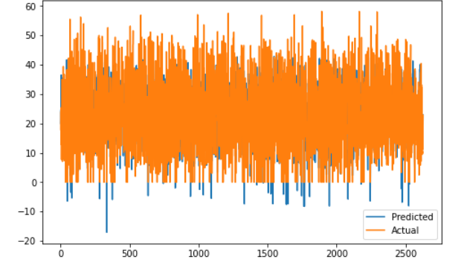
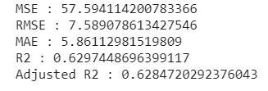
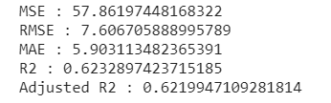
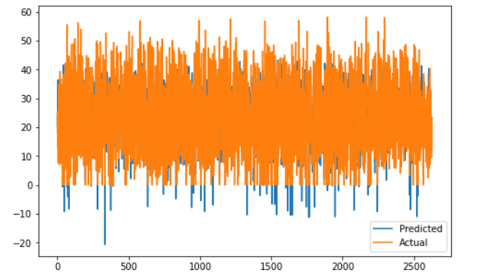
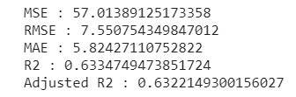
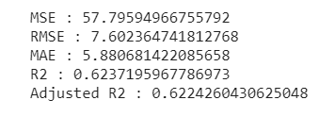
Lasso Regression
Train Set Metrics Test Set Metrics
Ridge Regression
Train Set Metrics Test Set Metrics

Slide 17
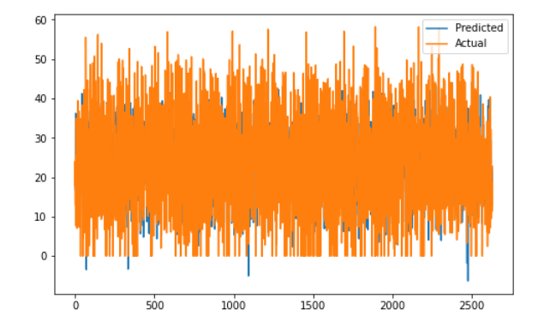
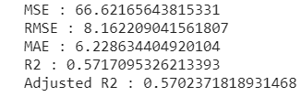
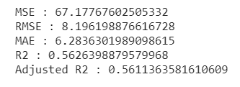
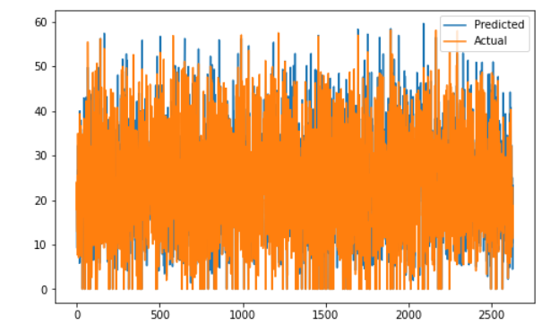
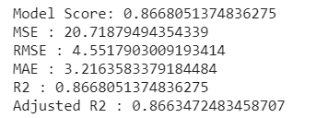
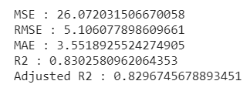
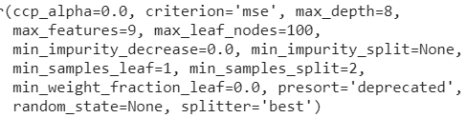
ElasticNet Regression Decision Tree
Train Set Metrics Test Set Metrics
Train Set Metrics Test Set Metrics
Hyper parameter

Slide 18
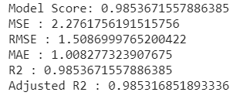
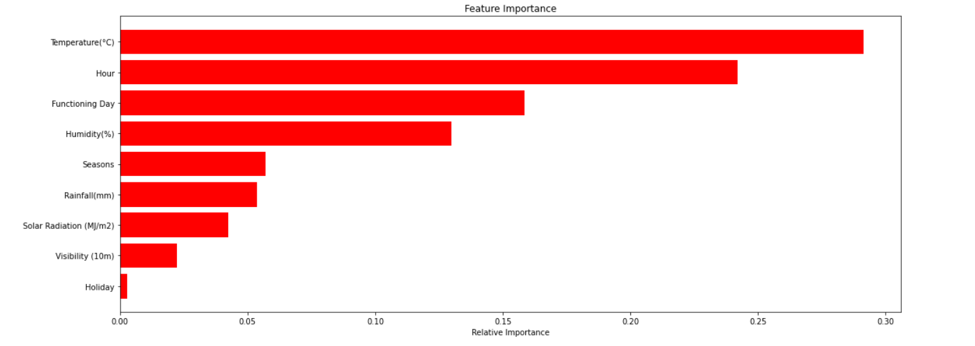
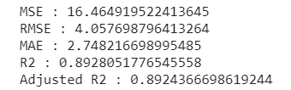

Random Forest
Train Set Metrics Feature Importance
Test Set Metrics
Hyper parameter

Slide 19
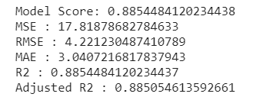
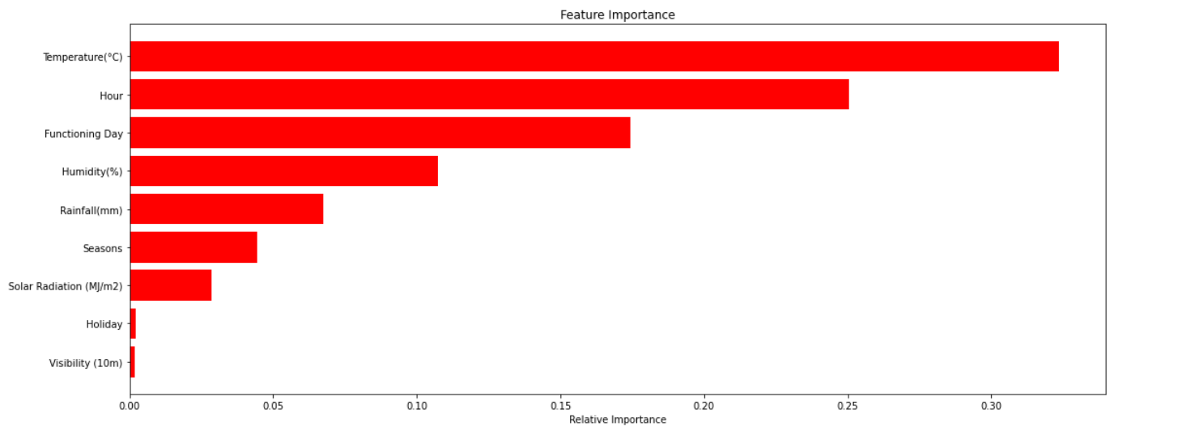
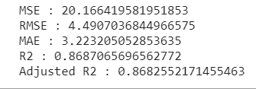

Gradient Boosting Machine
Train Set Metrics Feature Importance
Test Set Metrics
Hyper parameter

Slide 20
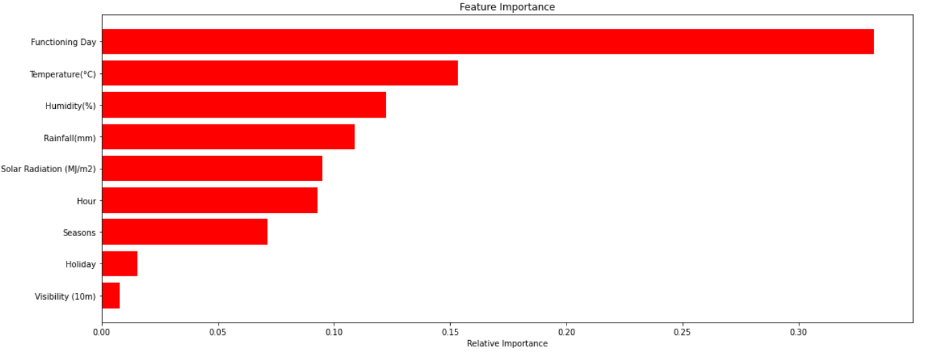
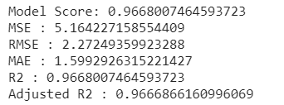
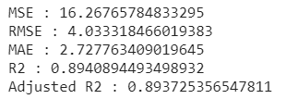
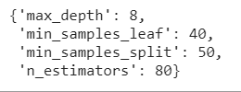
XGBoost
Train Set Metrics Feature Importance
Test Set Metrics
Hyper parameter

Slide 21
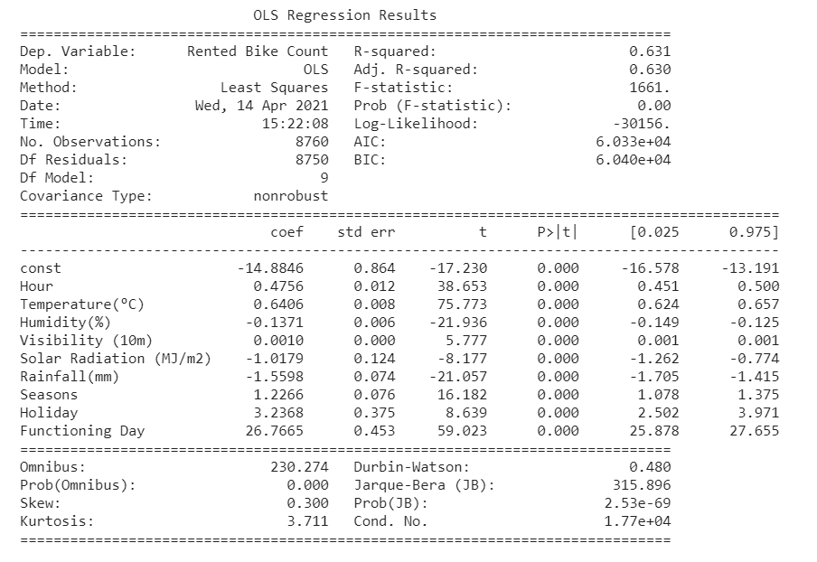
Linear Regression using Statsmodels

Slide 22
Challenges
Large Dataset to handle.
Needs to plot lot of Graphs to analyse.
Carefully handled Feature selection part as it affects the R2 score.
Carefully tuned Hyperparameters as it affects the R2 score.

Slide 23
Conclusion
The Rented Bike Count has been increased from 2017 to 2018.
No overfitting is seen.
XGBoost Regressor gives the highest R2 score of 96.6% for Train Set and 89.4% for Test set.
Feature Importance value for Random Forest, Gradient Boost, and XGBoost are different.
We can deploy this model.

Slide 24
THANK YOU Q & A

